Slide 1
Handling E-Mail
Notes:
1
1

Slide 2
E-mail System
E-mail system comprises of the following three components:
Mailer
Mail Server
Mailbox
Mailer : It is also called mail program, mail application or mail client. It allows us to manage, read and compose e-mail.
Mail Server: The function of mail server is to receive, store and deliver the email. It is must for mail servers to be sunning all the time because if it crashes or is down, email can be lost.
Mailboxes: Mailbox is generally a folder that contains emails and information about them.
Notes:
2
2

Slide 3
Working of E-mail
A better understanding of working of email system:
Suppose person A wants to send an email message to person B.
Person A composes the messages using a mailer program i.e. mail client and then select Send option.
The message is routed to Simple Mail Transfer Protocol to person B’s mail server.
The mail server stores the email message on disk in an area designated for person B.
Notes:
3
3

Slide 4
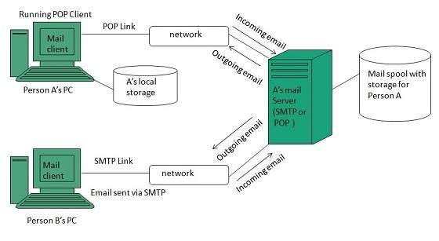
Notes:
4
4

Slide 5
Protocols
A protocol is about a standard method used at each end of a communication channel, in order to properly transmit information
In order to deal with your email you must use a mail client to access a mail server.
the most commonly used Email protocols on the internet - POP3, IMAP and SMTP.
Each one of them has specific function and way of work.
Notes:
5
5

Slide 6
IMAP
IMAP stands for Internet Mail Access Protocol.
There exist five versions of IMAP as follows:-
Original IMAP,IMAP2,IMAP3,IMAP2bis,IMAP4
IMAP allows users to store their email on remote servers.
The e-mail is hold and maintained by the remote server.
It enables us to take any action such as downloading, delete the mail without reading the mail.
It enables us to create, manipulate and delete remote message folders called mail boxes.
IMAP enables the users to search the e-mails.
It allows concurrent access to multiple mailboxes on multiple mail servers.
Notes:
6
6

Slide 7
SMPTP
SMTP stands for Simple Mail Transfer Protocol.
It was first proposed in 1982. It is a standard protocol used for sending e-mail efficiently and reliably over the internet.
SMTP is application level protocol.
SMTP is connection oriented protocol.
SMTP is text based protocol.
It handles exchange of messages between e-mail servers over TCP/IP network.
Simple Mail Transfer Protocol (SMTP) is a TCP/IP protocol used in sending and receiving e-mail.
Most e-mail systems that send mail over the Internet use SMTP to send messages from one server to another.
Notes:
7
7

Slide 8
POP
POP stands for Post Office Protocol.
It is generally used to support a single client.
There are several versions of POP but the POP 3 is the current standard.
POP is an application layer internet standard protocol.
Since POP supports offline access to the messages, thus requires less internet usage time.
POP is used to download emails from a remote server.
Notes:
8
8

Slide 9
The settings that you need to use –
Smtp server address – smtp.gmail.com
Port – 587 or 465
EnableSsl – true
Gmail always uses SSL authentication, hence you need to enable the SSL property on port 587 or 465 to send email in c#. As given above, the smtp address of the gmail is “smtp.gmail.com“.
Notes:
9
9

Slide 10
import email, smtplib, ssl from email
import encoders from email.mime.base
import MIMEBase from email.mime.multipart
import MIMEMultipart from email.mime.text
import MIMEText subject = "An email with attachment from Python" body = "This is an email with attachment sent from Python" sender_email = "my@gmail.com" receiver_email = "your@gmail.com" password =
("Type your password and press enter:")
# Create a multipart message and set headers message = MIMEMultipart() message["From"] = sender_email message["To"] = receiver_email message["Subject"] = subject message["Bcc"] = receiver_email
# Recommended for mass emails
# Add body to email message.attach(MIMEText(body, "plain")) filename = "document.pdf“
# In same directory as script
# Open PDF file in binary mode with
(filename, "rb") as attachment:
# Add file as application/octet-stream
# Email client can usually download this automatically as attachment
part = MIMEBase("application", "octet-stream") part.set_payload(attachment.read())
# Encode file in ASCII characters to send by email encoders.encode_base64(part)
# Add header as key/value pair to attachment part part.add_header( "Content-Disposition", f"attachment; filename= {filename}", )
# Add attachment to message and convert message to string message.attach(part) text = message.as_string()
# Log in to server using secure context and send email context = ssl.create_default_context() with smtplib.SMTP_SSL("smtp.gmail.com", 465, context=context) as server: server.login(sender_email, password) server.sendmail(sender_email, receiver_email, text)

Slide 11
THANK YOU

Slide 15
END..
Notes:
15
15

